Slide 1

Formulating Problem Statements
Notes:
Thank you.
cross-functional effort amongst W&M and IS teams; 100% buy-in on the need for planning from middle-management
have not brought yet to data, IT supply chain, infra, IT Sec and others into fold.

Slide 2
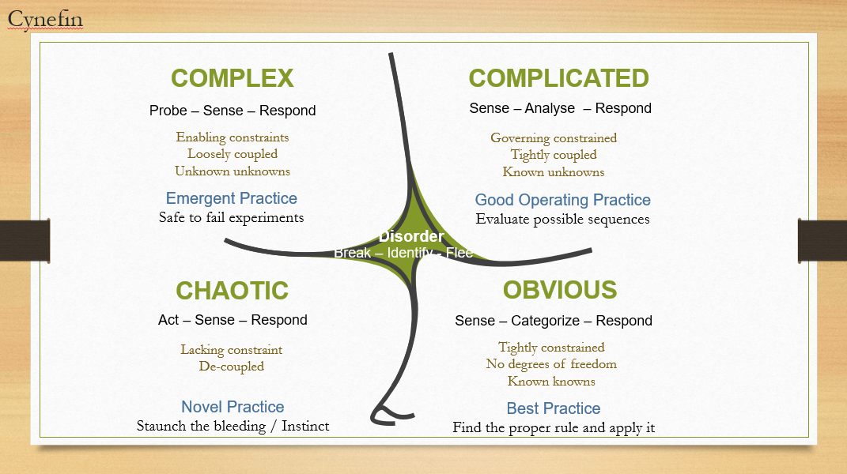
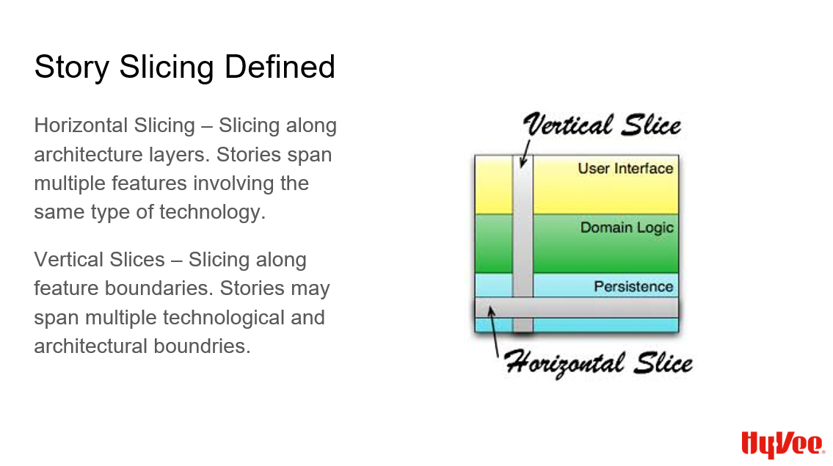
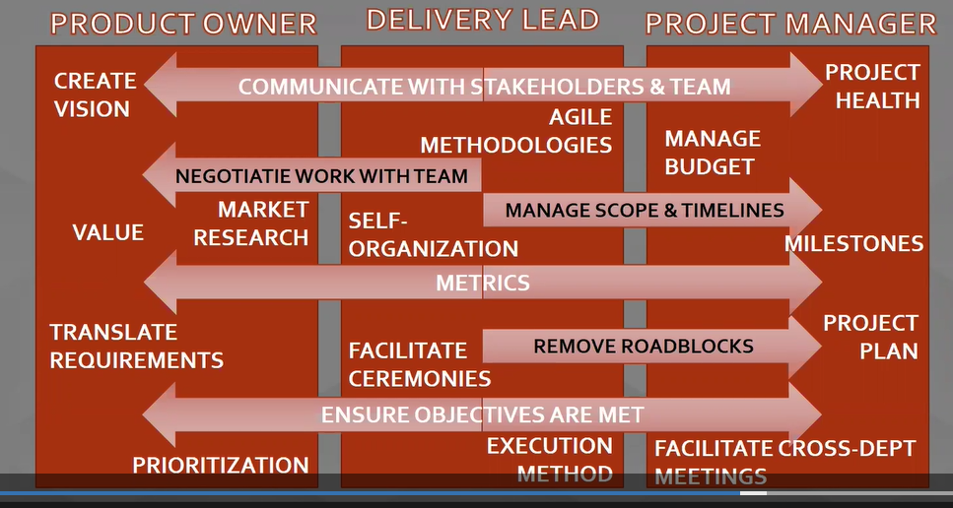
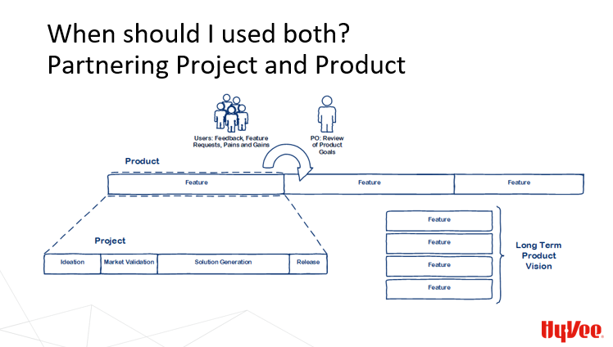
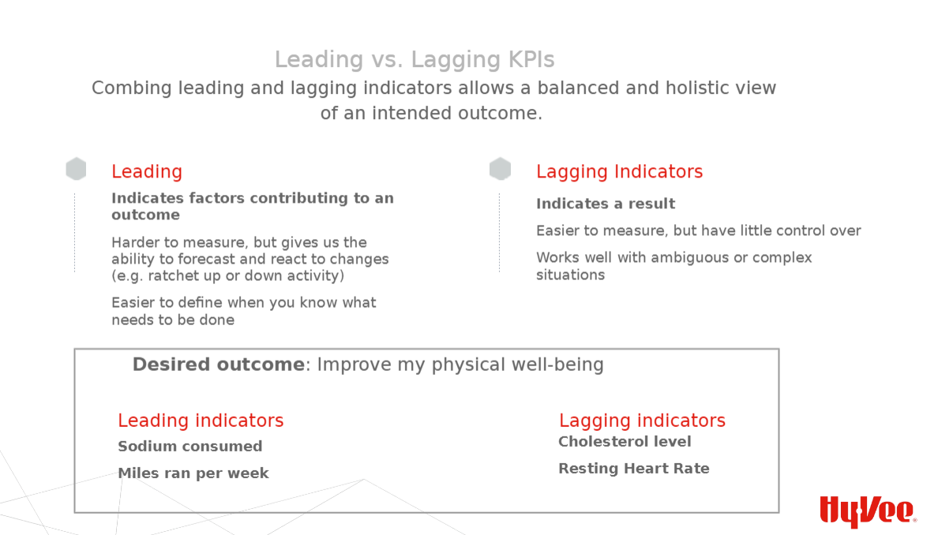
We rejoin our heroes with a large complex problem…
#growth-and-learning-series
https://confluence.hy-vee.com/display/ITMain/Training+Videos

Slide 3


Slide 4


Slide 5
What went wrong?
Finley heard what she wanted to hear
She came with a preferred plan of action
Thalia came with a solution in mind
She couldn’t communicate her actual needs because she was emotional
Humans are fallible and terrible at communicating

Slide 6
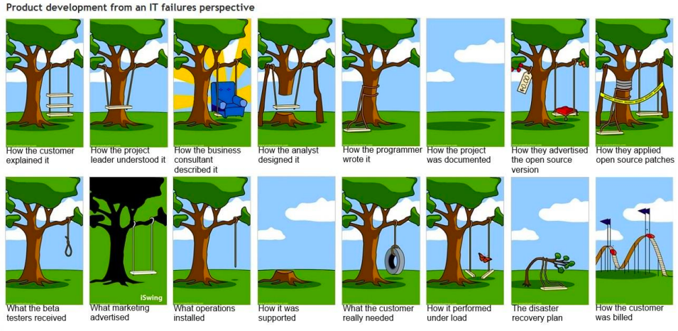
Solving the wrong problem

Slide 7
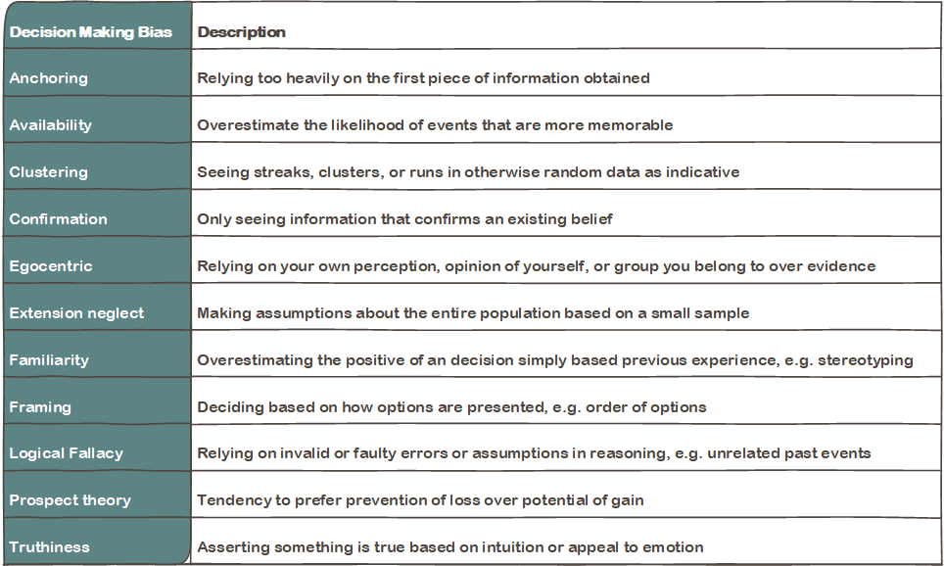

Decision Making Biases

Slide 8
“A problem well put is half solved.”
― John Dewey

Slide 9

Problem Statements:
The who, what, where, why of motivations
Solution Statements:
The how or tactics that addresses the problem
Notes:
Who, what, where, why – problem statement
How – solution statement

Slide 10
Goals of a Problem Statement
Separate decision making from cognitive biases
Establish a common language
Create a shared user-focused context around the actual problem on which to test solutions
Allow solutions to be more resilient by putting them in the system context instead of the user context
Support small testable hypotheses
Separate the signal of the problem from the noise of the technical system we are operating in

Slide 11
Problem Statements are not valuable in all situations
Use Problem Statements
Use Other Tools
Troubleshooting support tickets
Feature discovery
Problem-solution fit
Product-market fit *
Convincing someone their solution is wrong
Technical implementation discussions *
Business model fit
Notes:
Product market fit lays on a good foundation of problem solution fit. If you are just starting to develop your problem statements here, you aren’t at product-market fit. But if you are trying to see if those problem statements have a larger appeal, you are. There are similar tools here, but different goals
Technical implementations should start with a developed problem statement and constantly reflect back on them to make sure the solution solves the problem

Slide 12
Tools: Talk to Users – the Problem Interview
What activities or jobs are they trying to complete?
What is impeding them from those actions?
What workarounds are they using to get around the software’s limitations?
Why do they want to accomplish that action?
Why do they feel pain with the current process?
Notes:
Start trying this out with troubleshooting tasks

Slide 13
User Interview Tips
Set the stage that you may ask dumb questions
Focus on user behavior, not system actions
Listen to user’s dreams, but don’t start brainstorming solutions
Watch out for cognitive biases
Stay open and actively listening
“What I hear you saying is X.” Or “I believe what you are trying to do is Y.”

Slide 14
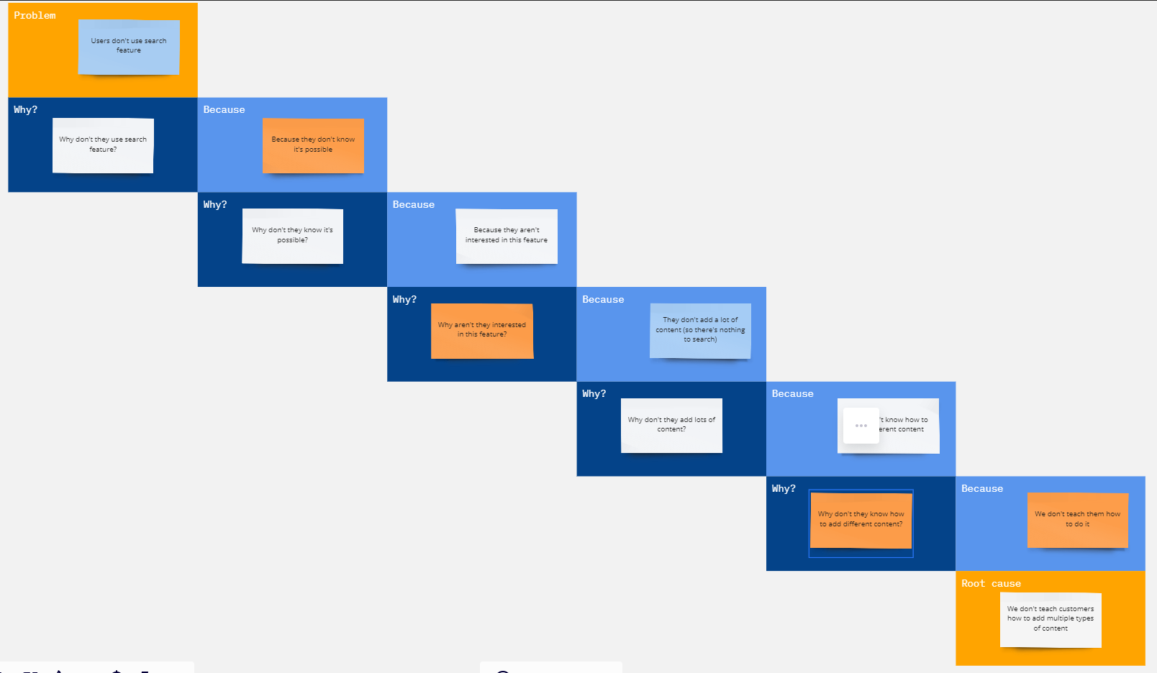
Tool: Push deeper – the five whys
Miro template >

Slide 15
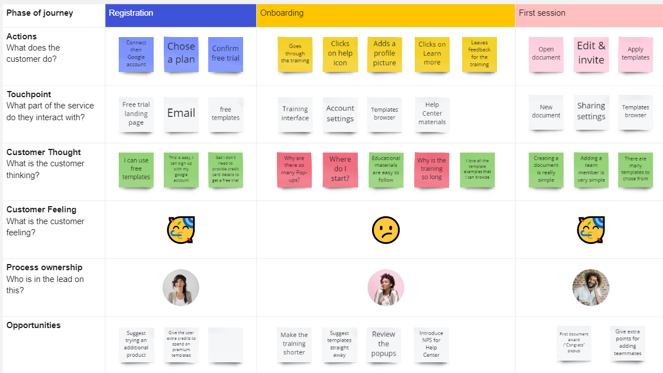
Tool: Customer Journey Mapping
Miro template >

Slide 16
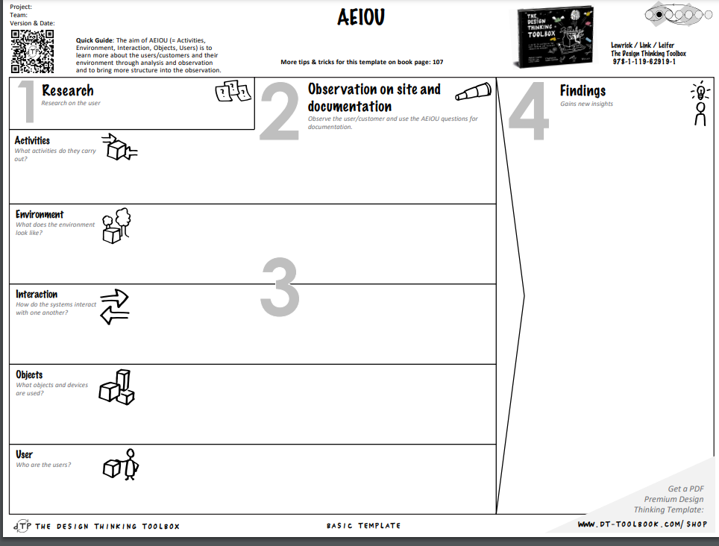
Tool: AEIOU
https://en.dt-toolbook.com/aeiou-en >

Slide 17
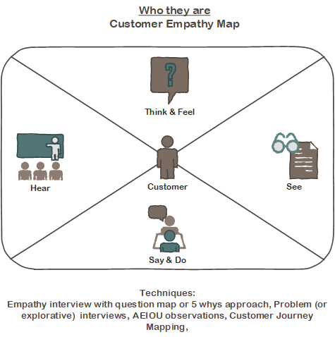
Specific, repeatable user actions
To understand expected, measurable customer behavior

Slide 18
Formulate a Problem Statement
As a type of user
I want to complete a job
But limitation I am facing me
Because description of the system impeding the user
Which makes me feel emotion
Notes:
Note that the description of system impeding the user will become part of the solution statement later but should not be a complete recommended solution. It is the beginning of the solution discovery process. Also, the emotion aspect will help you in prioritization in combination with the criticality of the job the user is trying to complete and the type of user facing the problem.

Slide 19
Thalia’s Problem Statement
As a 2-year-old with control issues
I want to eat my yogurt
But I don’t have a spoon I like
Because I want my spoon to match my plate and cup and Finley has the pink yogurt spoon
Which makes me feel emotions, so, so many emotions, because I’m two and everything makes me feel emotions. And I don’t have many words yet.
Testable hypothesis you can validate a solution against
Notes:
We will have an upcoming talk on hypothesis testing

Slide 20
Questions and Conversation

Slide 21
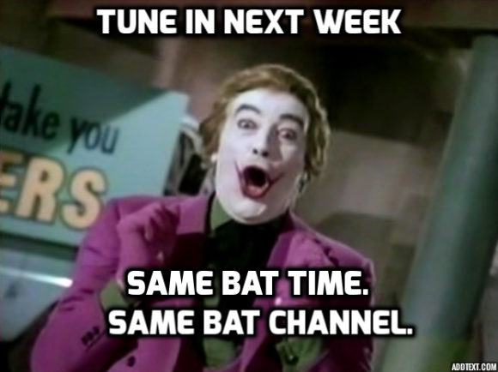
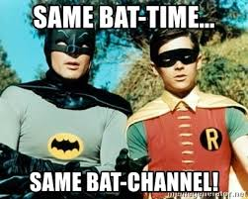
March 11th: Concourse and Ansible Pipeline to the S1s
March 18th: What is UX and when to engage the UX team?

